Slide 1

Semiconductor Manufacturing Reshoring - Workforce Readiness in East Asia
Comprehensive analysis on semiconductor manufacturing reshoring impacts on East Asian workforce readiness targeting industry executives.
AI-Generated Presentation • Confidential

Slide 2
Executive Summary
1
2
3
4
5
Global Transformation
Geopolitical Tensions
Technological Sovereignty
Supply Chain Resilience
Workforce Challenge
33% increase in semiconductor workforce demand by 2030
U.S. CHIPS Act and EU Chips Act driving domestic production
Leading foundries expanding internationally
Southeast Asia and Eastern Europe emerging as key hubs
Significant gaps in technical skills
2

Slide 3
Key Statistics
TOTAL INVESTMENT
GLOBAL MARKET SIZE
WORKFORCE DEMAND
AVERAGE MONTHLY WAGE
$52 billion
$471 billion
33%
$9.6 billion
U.S. CHIPS Act funding
projected semiconductor market size
increase in semiconductor workforce demand by 2030
average monthly wage in key East Asian economies
3

Slide 4

Taiwan's Semiconductor Industry
1
$470 billion market size, with TSMC as a leading player
East Asian Semiconductor Manufacturing Ecosystem
South Korea's Semiconductor Industry
2
$33.0% market share, with Samsung as a major player
Japan's Semiconductor Industry
3
$9.6 billion investment in semiconductor manufacturing
China's Semiconductor Industry
4
significant growth and investment in domestic production
Southeast Asia's Emerging Role
5
emerging as a key regional hub for semiconductor manufacturing
4

Slide 5
Regional Comparison
COUNTRY
WORKFORCE COST POSITIONING AND STRATEGIC ADVANTAGE
Taiwan: Low workforce cost positioning, with a strategic advantage in semiconductor manufacturing
Southeast Asia: Low workforce cost positioning, with a strategic advantage in emerging market growth
South Korea: Medium workforce cost positioning, with a strategic advantage in electronics manufacturing
Japan: High workforce cost positioning, with a strategic advantage in technological expertise
China: High workforce cost positioning, with a strategic advantage in domestic market size
Global Competition: India-based freelancers compete with Eastern Europe on Upwork, often undercutting by 40-60% on hourly rates
5

Slide 6
Semiconductor Workforce Demand and Training Initiatives
REGION / METRIC
VALUE (2025–2030)
NOTES
Global workforce growth needed
33.0%
Projected increase by 2030 5
Unfilled technical roles
67,000
Due to low technical degree completion 5
Global skilled workforce needed
1,000,000
Deloitte projection by 2030 6
Thailand semiconductor trainees
80,000
Target by 2029 7
4 records · 3 metrics · Source: Document Analysis
6

Slide 7
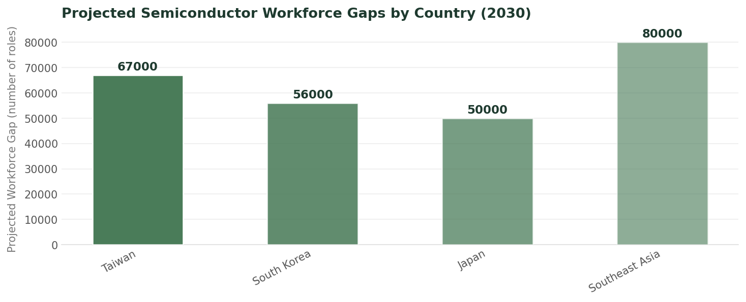
Projectted Semiconductor Workforce Gaps by Country
Data visualization from document analysis
📊
7

Slide 8
Industry-Education Collaboration Models
01
02
03
04
05
Apprenticeships
Training Programs
Curriculum Development
Mentorship
Partnerships
Collaborative programs between industry and education institutions
Customized training programs for semiconductor workforce development
Development of specialized curriculum for semiconductor manufacturing
Mentorship programs for semiconductor workforce development
Partnerships between industry, education, and government for workforce development
8

Slide 9
Timeline of Semiconductor Manufacturing Reshoring
EU Chips Act introduced
Southeast Asia and Eastern Europe emerge as key hubs
2020
2023
2030
U.S. CHIPS Act introduced
2022
Leading foundries expand internationally
2025
Projected 33% increase in semiconductor workforce demand
9

Slide 10

33% Increase in Semiconductor Workforce Demand by 2030
The semiconductor industry faces a significant workforce challenge
Technical skills gap
Increasing demand for skilled workers
Need for industry-education collaboration
10

Slide 11

Invest in Education and Training
1
Develop specialized curriculum and training programs
Executive Strategies for Workforce Development
Industry-Education Collaboration
2
Collaborative programs between industry and education institutions
Mentorship and Apprenticeships
3
Mentorship and apprenticeship programs for semiconductor workforce development
Diversity and Inclusion
4
Promote diversity and inclusion in the semiconductor workforce
Global Talent Acquisition
5
Attract global talent to the semiconductor industry
11

Slide 12

Conclusion
→
→ 33% increase in semiconductor workforce demand by 2030
→
→ Significant gaps in technical skills
→
→ Need for industry-education collaboration
→
→ Importance of diversity and inclusion in the semiconductor workforce
→
→ Global talent acquisition and retention strategies
12

